Slide 1
Analysis of Aviation Accidents
By Redon N Roy

Slide 2
Overview
The project deals with the analysis of the historical data related to the accidents that has occurred in the aviation sector and trying to find out answers to various questions such as:
At what phase of the flight do most of the accidents occur?
Which make of the aircraft suffered the most accidents?
What is the influence of weather on these accidents?
What phase resulted in fatal accidents?
And more…..
Analysis of Aviation Accidents

Slide 3
Technologies Used
HIVE
HADOOP
SQOOP
MYSQL
Analysis of Aviation Accidents

Slide 4
Operations performed on Data
Loading the data into Hive table
Applying various filter operations with WHERE clause
Grouping of data
Ordering of data
Partitioning of the Hive table based on appropriate columns
Exporting the query result to HDFS
Importing the query result into MySQL
Analysis of Aviation Accidents

Slide 5
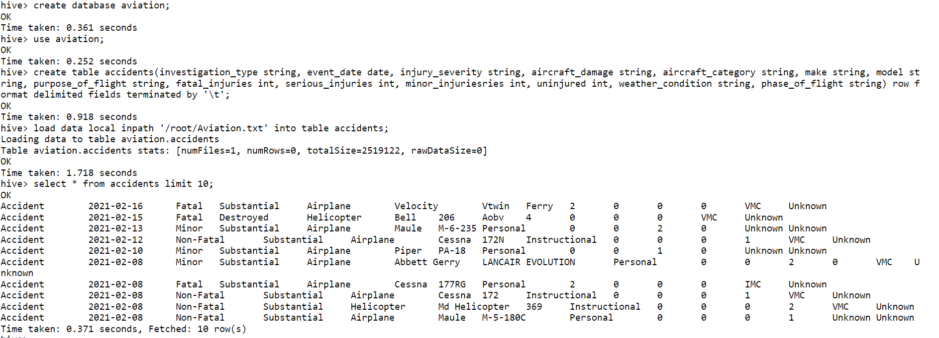
Creating the database
We will be creating and using the aviation database as:-
create database aviation;
use aviation;
Analysis of Aviation Accidents

Slide 6
Creating and Loading the Hive table
We will be creating the accidents table and load the data from local storage into the Hive table as:-
create table accidents(investigation_type string, event_date date, injury_severity string, aircraft_damage string, aircraft_category string, make string, model string, purpose_of_flight string, fatal_injuries int, serious_injuries int, minor_injuriesries int, uninjured int, weather_condition string, phase_of_flight string) row format delimited fields terminated by '\t’;
load data local inpath '/root/Aviation.txt' into table accidents;
Analysis of Aviation Accidents

Slide 7
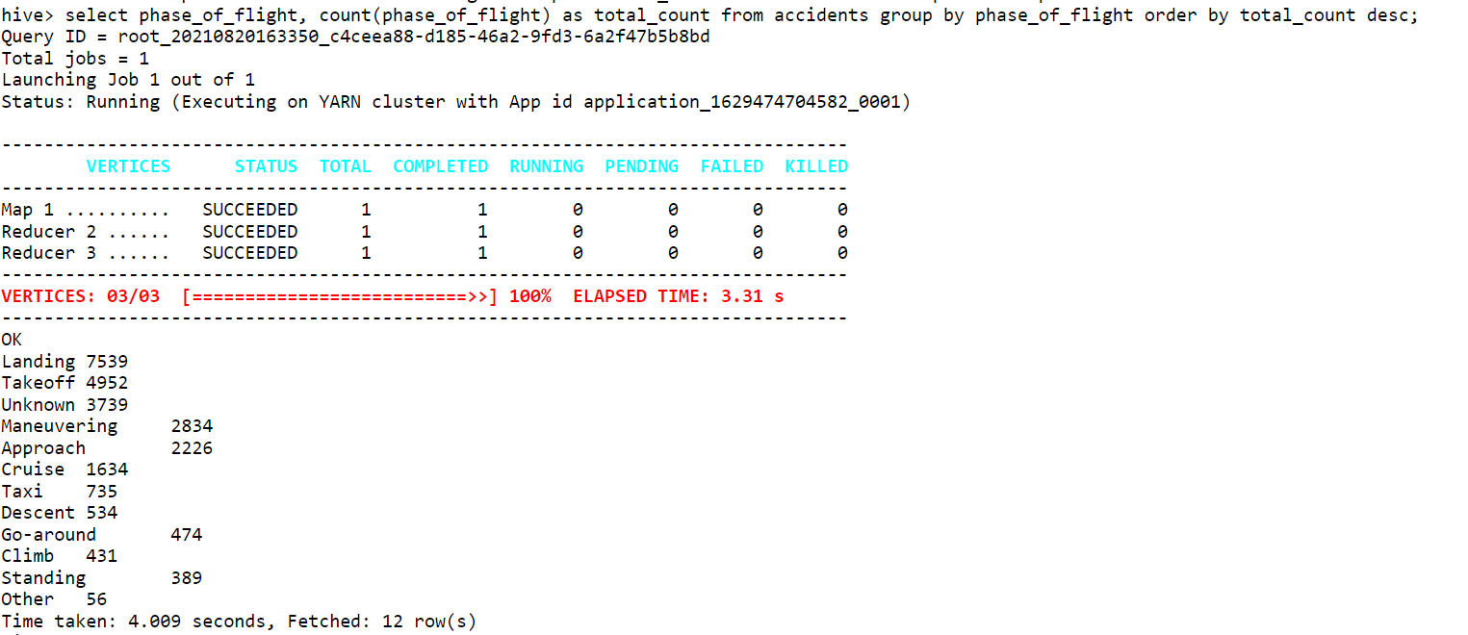
Finding Phase having most accidents
Finding out the phase of the flight at which most of the accidents occur. This is done counting and grouping the phase_of_flight column and ordering the count in descending order.
select phase_of_flight, count(phase_of_flight) as total_count from accidents group by phase_of_flight order by total_count desc;
Analysis of Aviation Accidents

Slide 8
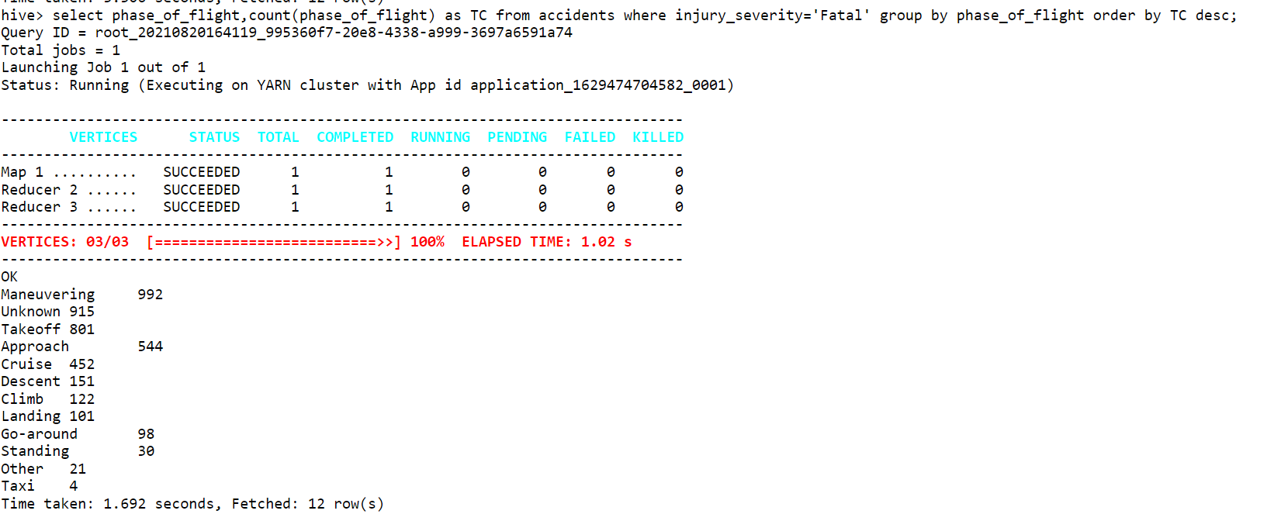
Finding Phase having most Fatal accidents
Finding out the phase of the flight at which most of the fatal accidents occur. This is done counting and grouping the phase_of_flight column, ordering the count in descending order and keeping injury_severity as ‘Fatal’.
select phase_of_flight,count(phase_of_flight) as TC from accidents where injury_severity='Fatal' group by phase_of_flight order by TC desc;
Analysis of Aviation Accidents

Slide 9
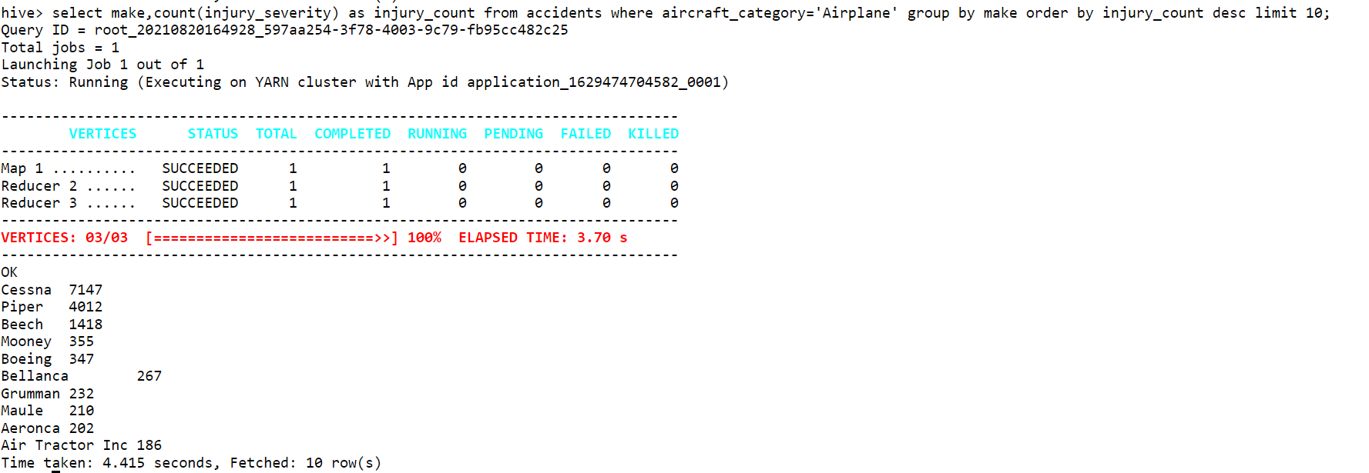
Finding Make of Airplane having most accidents
Finding out the make of the airplane which suffered the most fatal accidents. This is done by counting the injury_severity, grouping by the make and ordering by injury count.
select make,count(injury_severity) as injury_count from accidents where aircraft_category='Airplane' group by make order by injury_count desc limit 10;
Analysis of Aviation Accidents

Slide 10
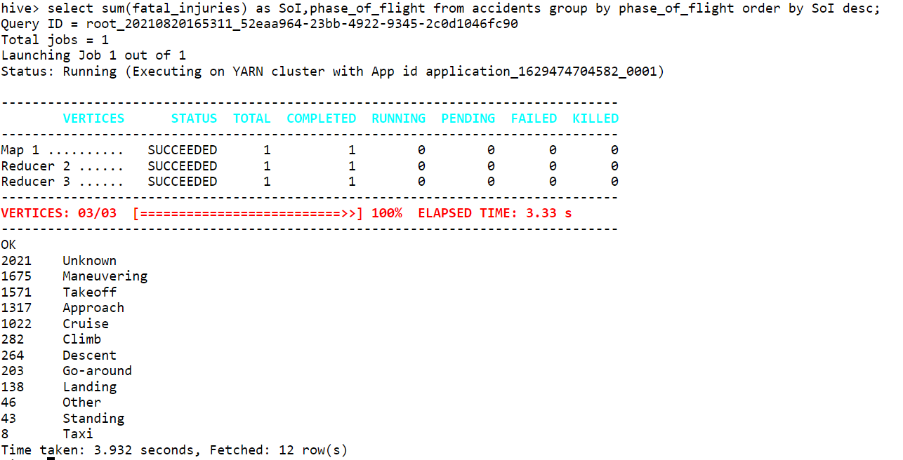
Finding number of fatalities for each phase
Finding out the total number of fatalities that has occurred for each phase of filght between 1979 and 2021
select sum(fatal_injuries) as SoI,phase_of_flight from accidents group by phase_of_flight order by SoI desc;
Analysis of Aviation Accidents

Slide 11
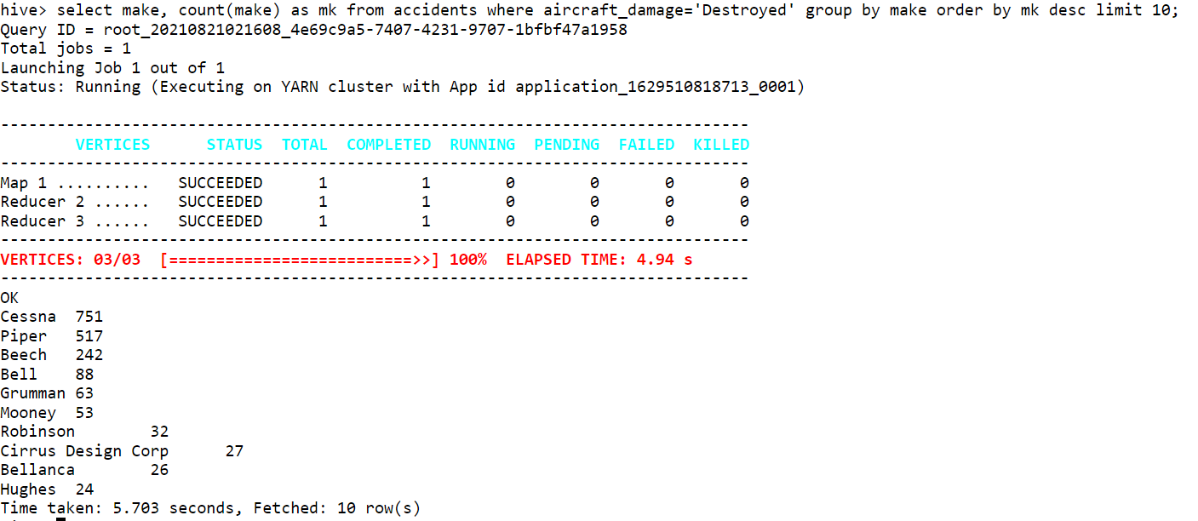
Finding the make that was destroyed the most in accidents
Finding out the make of the aircraft that was destroyed the most in an accident. This is done by counting makes having aircraft_damage as ‘Destroyed’.
select make, count(make) as mk from accidents where aircraft_damage='Destroyed' group by make order by mk desc limit 10;
Analysis of Aviation Accidents

Slide 12
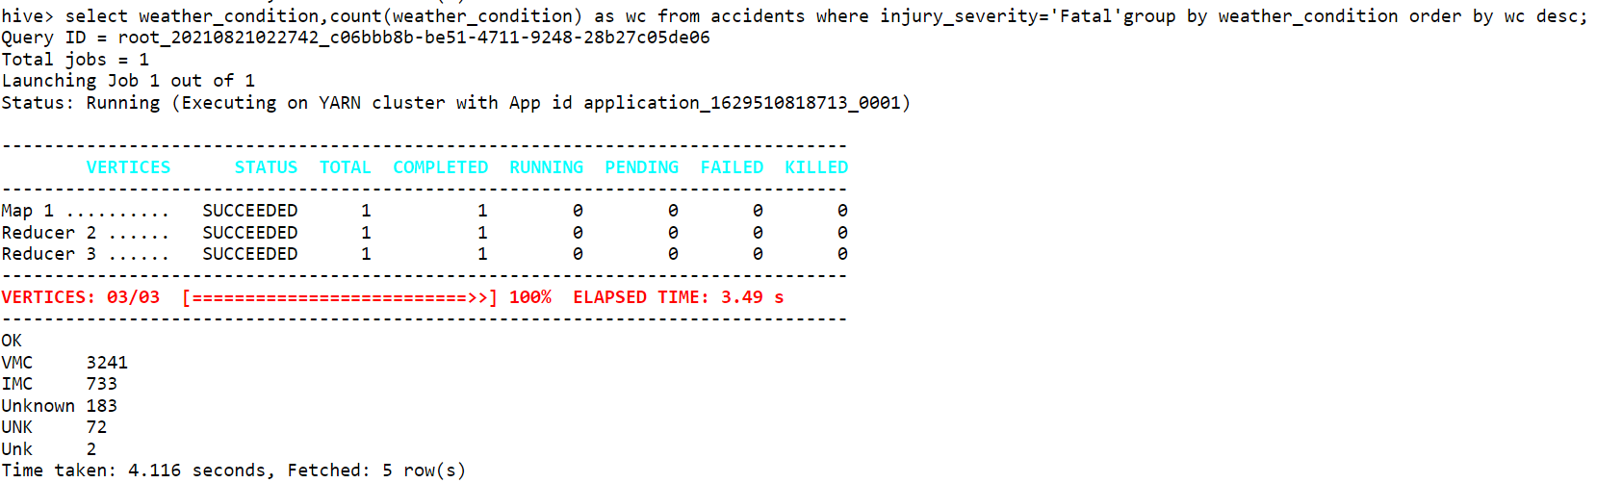
Finding the effect of weather conditions in accidents
Finding out at what weather conditions most of the fatal accidents has occurred. This is done by counting and grouping the weather_condition column.
select weather_condition,count(weather_condition) as wc from accidents where injury_severity='Fatal'group by weather_condition order by wc desc;
Analysis of Aviation Accidents

Slide 13
Creating a table for dynamic partitioning
Creating a table accidents_pt so that we can partition the accidents table dynamically based on injury_severity and phase_of_flight.
create table accidents_pt(investigation_type string, event_date date, aircraft_damage string, aircraft_category string, make string, model string, purpose_of_flight string, fatal_injuries int, serious_injuries int, minor_injuriesries int, uninjured int, weather_condition string) partitioned by(injury_severity string, phase_of_flight string);
set hive.exec.dynamic.partition.mode=nonstrict;
Analysis of Aviation Accidents

Slide 14
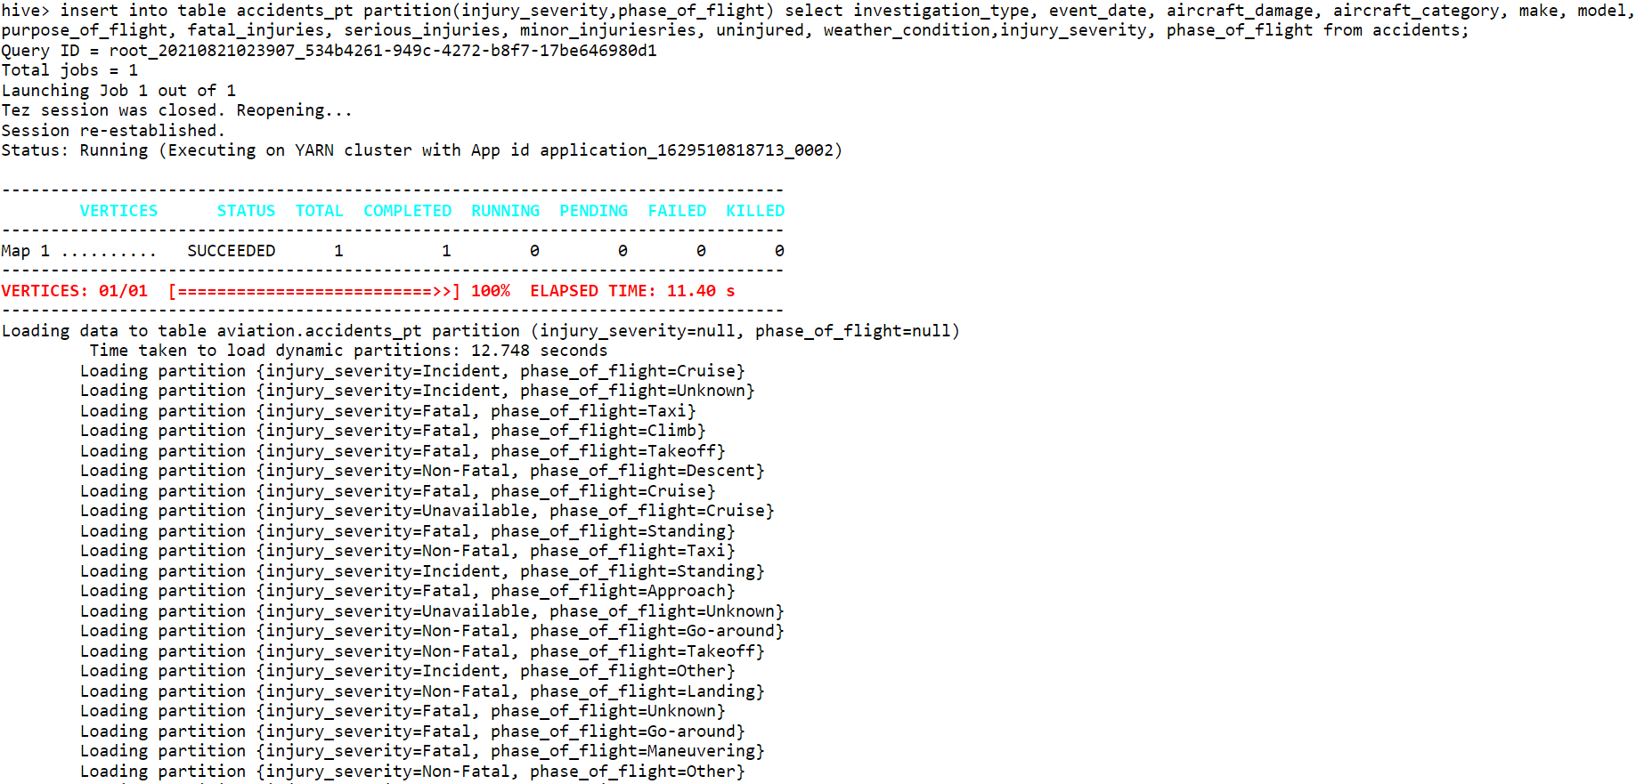
Inserting data into partition table
Inserting data into the partition table accidents_pt from the original table accidents.
insert into table accidents_pt partition(injury_severity,phase_of_flight) select investigation_type, event_date, aircraft_damage, aircraft_category, make, model, purpose_of_flight, fatal_injuries, serious_injuries, minor_injuriesries, uninjured, weather_condition,injury_severity, phase_of_flight from accidents;
Analysis of Aviation Accidents

Slide 15
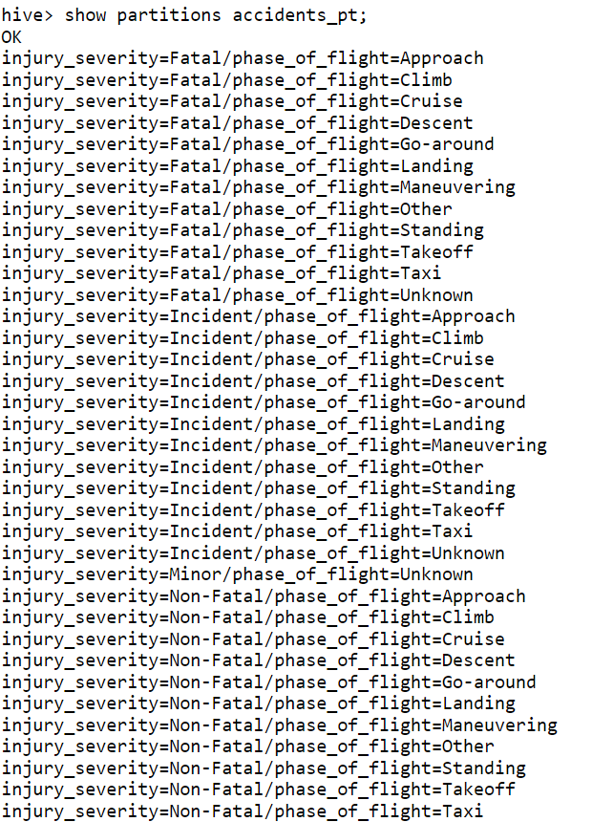
Displaying the partitions
Displaying the various partitions that were dynamically created by Hive.
show partitions accidents_pt;
Analysis of Aviation Accidents

Slide 16
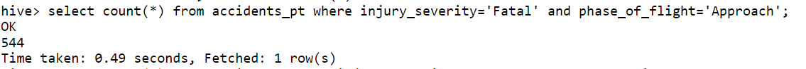

Running same query on partition table and normal table
Querying the same data from normal table and partition table to see the difference in execution time.
select count(*) from accidents_pt where injury_severity='Fatal' and phase_of_flight = 'Approach';
select count(*) from accidents where injury_severity='Fatal' and phase_of_flight = 'Approach';
Analysis of Aviation Accidents

Slide 17
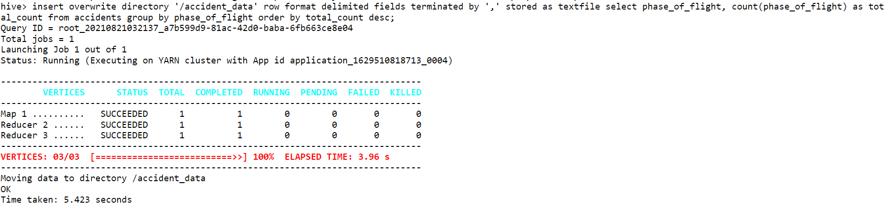
Exporting query result into HDFS
Exporting the result of a query into the HDFS as a text file where each of the fields are delimited by ‘,’.
insert overwrite directory '/accident_data' row format delimited fields terminated by ',' stored as textfile select phase_of_flight, count(phase_of_flight) as total_count from accidents group by phase_of_flight order by total_count desc;
Analysis of Aviation Accidents

Slide 18
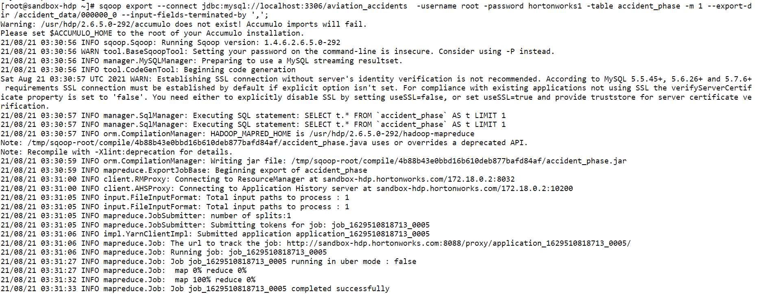
Writing the query result into MySQL with Sqoop
Writing the query result saved into HDFS into MySQL using Sqoop export
sqoop export --connect jdbc:mysql://localhost:3306/aviation_accidents -username root -password hortonworks1 -table accident_phase -m 1 --export-dir /accident_data/000000_0 --input-fields-terminated-by ',';
Analysis of Aviation Accidents

Slide 19
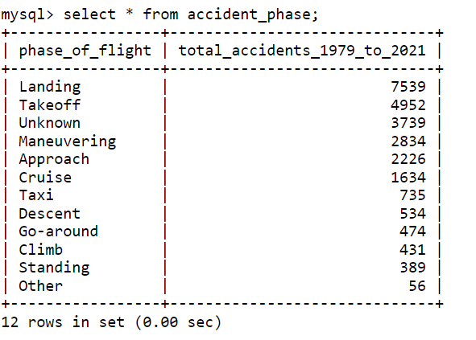
Writing the query result into MySQL with Sqoop
Displaying the query result written into MySQL using Sqoop
select * from accident_phase;
Analysis of Aviation Accidents

Slide 20
Conclusion
Most of the aircraft accidents occur at the “Landing” phase of the flight.
Most fatal accidents occurred at the “Manoeuvring” phase of the flight.
The passengers that suffered the most injuries we on aircraft made by “Cessna”.
The aircraft make that was destroyed the most in accidents is “Cessna”.
The weather condition in most accidents was VMC (Visual Meteorological Conditions)
Analysis of Aviation Accidents

Slide 21
Thank You

